Slide 1
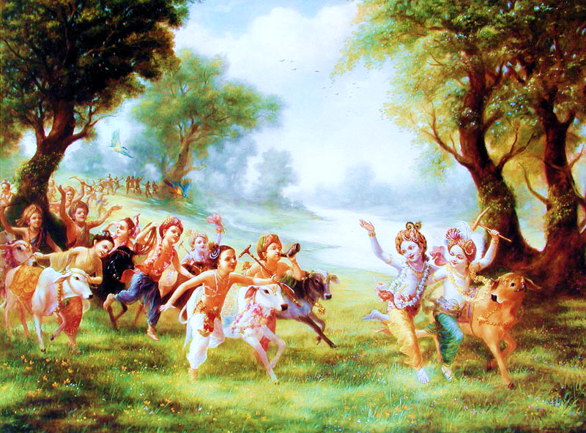
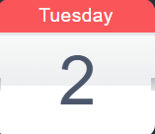
Discover
The Happy Planet
SPEAKER :
Ganesh Manikanta
B.Tech ECE
Business Analyst in Matasma Digital Technologies
DATE = 2nd January, 2024
TIME = 5:30 pm, Tuesday

